Slide 1
Booting from hard disk…
Starting Windos 95...
Press me

Slide 2


Slide 3
X

Slide 4
Coming soon
X
The dev has not made this feature yet!
Be patient!

Slide 5

Access denied
X
Your admin has denied access to this element of Windos.
Contact them about this if you still want to access it.

Slide 6
X

Slide 7

X

Slide 8

File Explorer
X

Slide 9
login
Username: username
Password: ********
Log in

Slide 10





Windos 95
Alpha 4
For testing purposes only
What’s new:
Added 2 new sites
Added email app
Fixed access denied screen
Changed feedback subject line
Added all apps shortcut. I need an icon, though.
Added screen tips for everything!
Hint of version:
Please hover over something before you click it and see what it does!
It could save you!

Slide 11
All apps
Explorer
Run
Find
Intranet explorer
Log off Username
Power off…

Slide 12
Power menu
X
Power off
Reboot
Log off
sleep

Slide 13
It is now safe to turn off your computer.
Restart
Press ESC to exit Windos now

Slide 15



All apps
X
Intranet explorer
Minecraft
email
explorer
Fortnite

Slide 16
Intranet explorer 16- CONNECTED
X
Welcome to the Intranet!
Tap on any of the underlined text to open that website!
Windos official site
Google
Bing

Slide 17

File Explorer
X
My computer
C:\

Slide 18
run
X
osod.exe
✓
X

Slide 19
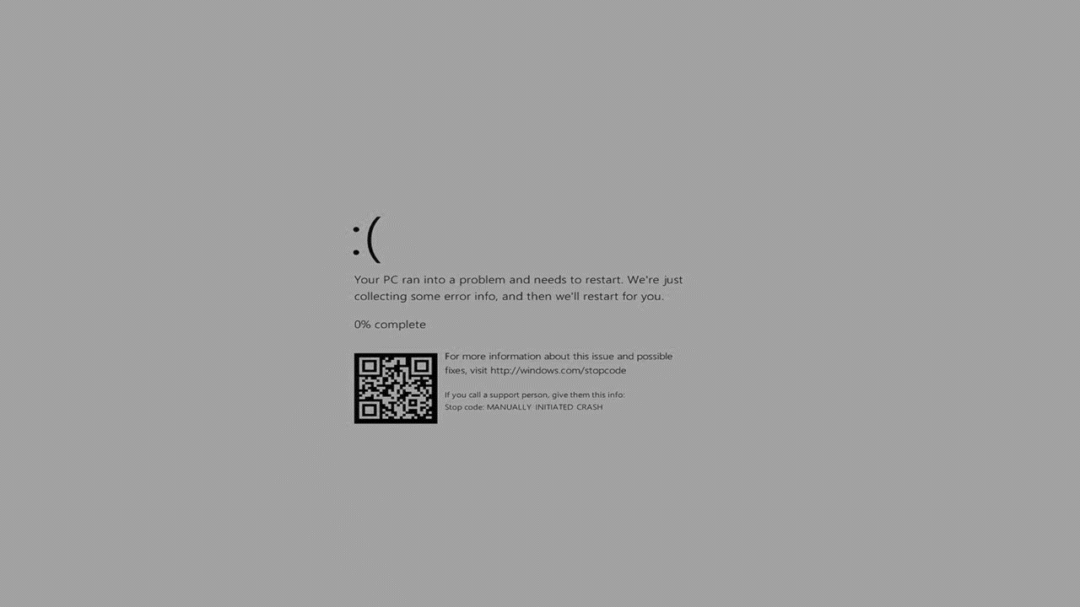

Slide 20

find
X
osod.exe
Found 1 file:
osod.exe
Press the button to open file

Slide 21


File Explorer
X
C:\
Windos
Program files
Windos.dll

Slide 22
Access denied
X
This PC has denied access to this file or folder.
Please contact the developer of Windos for ,more info.

Slide 23
Windos.com
X
Windos official site!
Welcome to the official site of Windos!
The latest official build is Windos 3 v1.01 but you can get Windos 95 alpha 3!
request a copy!
Feedback
Contact the developer

Slide 24
Windos. Com/copyrequest.html
X
Copy request:
Windos official site!
Windos 1 latest
Windos 2 latest
Windos 3 latest
Windos 95 latest alpha
Windos 95 waiting list
Request all Windos 1
Request all Windos 2
Request all Windos 3

Slide 25

Minecraft
X

Slide 26



Ew this game sucks
X

Slide 27
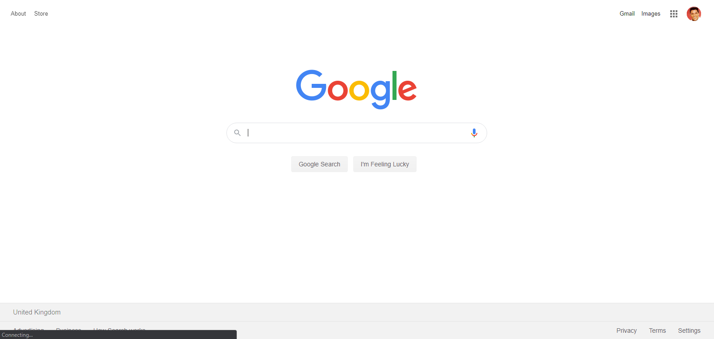
Google.com
X
Welcome to an archive of Google.com from 03/06/2020

Slide 28

Bing.com
X
As of 3/6/2020

